Slide 1

WeBWorK for Beginners!
Using and Developing for the Open Problem Library
Negar M. Harandi, Teaching and Learning Postdoc, Elec Engineering
Luis R. Linares, Sr. Instructor, Elec Engineering
Jonathan Verrett, Instructor, Chem and Bio Engineering
Agnes d’Entremont, Instructor, Mech Engineering

Slide 2
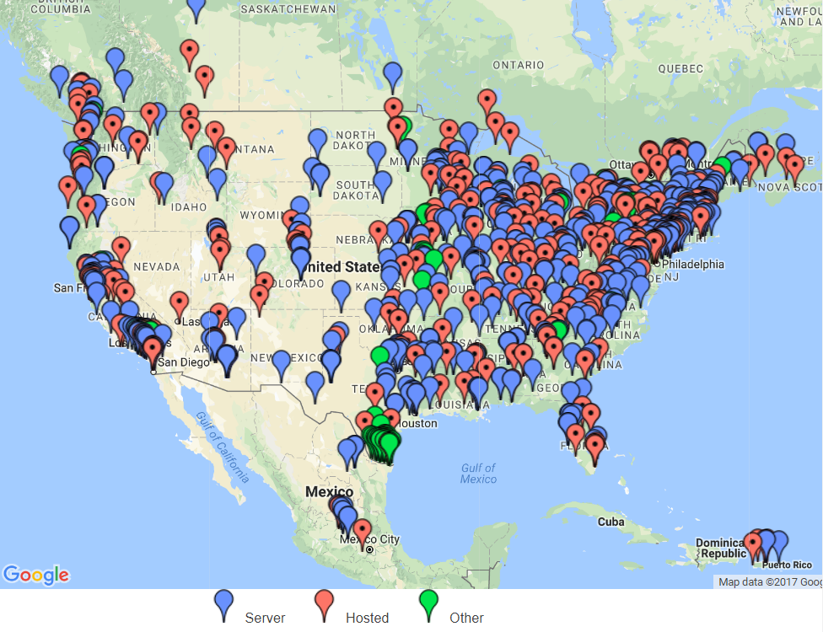
why WeBWORK?
Open-source and free
Customizable/student
Familiarity for students
Independent of LMS
Available UBC support
CTLT/CIS

Slide 3
What do students say about WeBWorK?
87.7%* rated their experience with WeBWorK satisfactory.
Immediate feedback (86%)
Review the material (81%)
Free of charge (78%)
Easier questions (70%)
Harder questions (58%)
Peer Discussion (44%)
*A recent survey carried in ELEC Engineering Department at UBC.

Slide 4
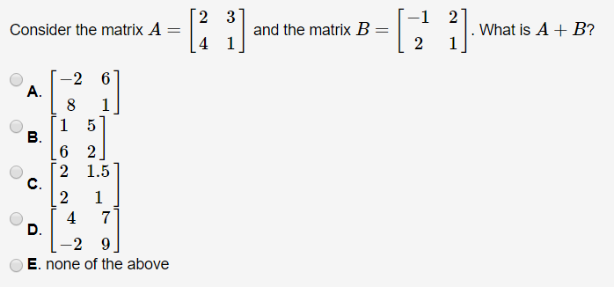
What Type OF Questions?

Slide 5
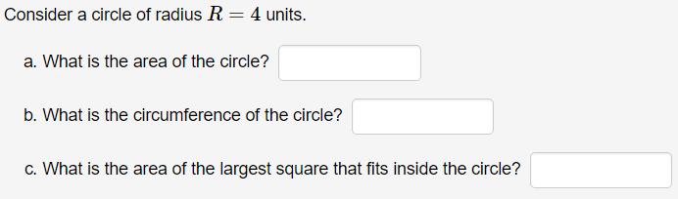
What TYPE OF Questions?

Slide 6
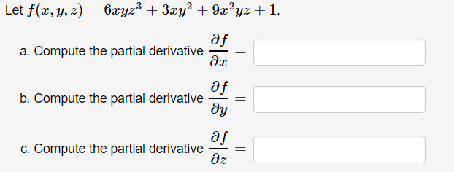
What TYPE OF Questions?

Slide 7
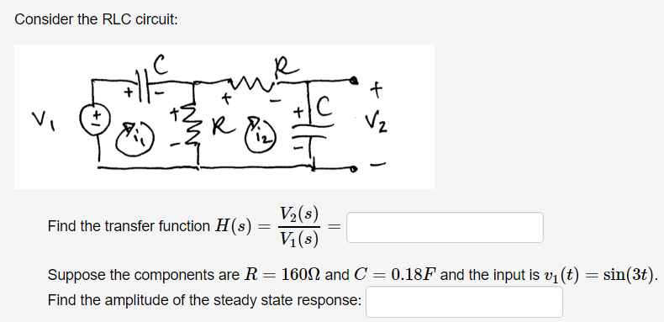
Where TYPE of Questions?

Slide 8
Where to start?
Course: APSC_WORKSHOP
webwork.elearning.ubc.ca
Create Yours
Modify Others’
Use Others’
Share with Others
Open Problem Library

Slide 9
Where to start?
webwork.elearning.ubc.ca
Create Yours
Modify Others’
Use Others’
Share with Others
webwork.maa.org/wiki
Open Problem Library

Slide 10
Building WeBWorK Questions
Negar M. Harandi
on behalf of Luis Linares

Slide 11
HOW ARE QUESTIONS DEFINED IN WEBWORK?
A question is a Perl source code file, with the extension pl or pg.
For example: Q1.pl, Q2.pl, etc.
You can use any text editor to open, modify or create your question file.
The questions reside on the WeBWorK server …

Slide 12
ANATOMY OF A QUESTION IN WEBWORK
In WeBWorK, a question has
A description
A figure (sometimes)
One (or more) randomized parameters
One (or more) answer formula(s), written as a function(s) of the randomized parameters
One (or more) entry box(es) for student answers

Slide 13
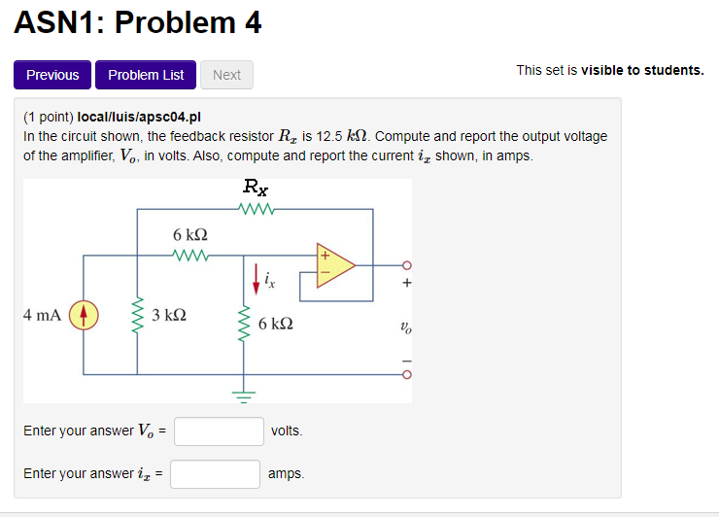
WHAT THE STUDENTS WILL SEE…

Slide 14
WHAT THE STUDENTS WILL SEE…

Slide 15
WHAT THE STUDENTS WILL SEE…

Slide 16
WHAT THE STUDENTS WILL SEE…

Slide 17
WHAT THE STUDENTS WILL SEE…

Slide 18

WHAT THE STUDENTS WILL SEE…
2.68

Slide 19
WHAT THE STUDENTS WILL SEE…
2.68

Slide 20
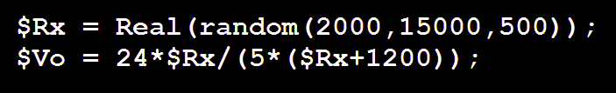
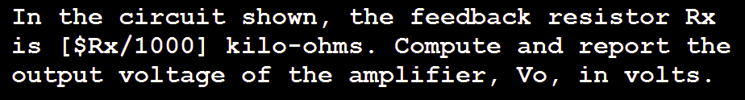
In the “code” we see … the description

Slide 21
In the “code” we see … random values
In Perl, a variable name begins with a $.

Slide 22
In the “code” we see … entry boxes

Slide 23
In the “code” we see … ANSWER FORMULAS

Slide 24
And … the figure…
apsc01.png

Slide 25
And … the figure in code…

Slide 26
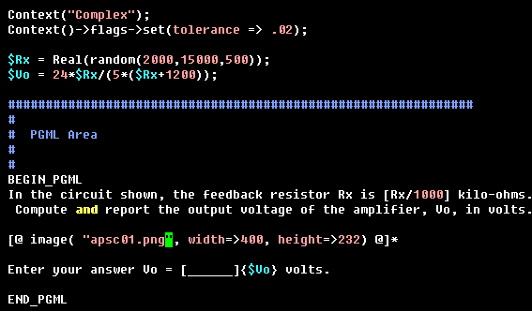
In the code, for real …
There is an error that
Would drive nuts the WWI.
Can you see it?

Slide 27
WHERE ARE THE “QUESTION FILE”?
WeBWORK
WeBWorK Server
Create a ‘local’ folder
Create an ‘ASN1’ folder
Create an ‘ASN2’ folder
……
Create an ‘ASN10’ folder
Inside each of those folders, you put your
question files, Q1.pg or Q1.pl, Q2,pg, etc.
image files, Q1.png, Q2.png, etc.
Local
ASN1
Q1.pl
ASN2
Q1.png
ASN3
Q2.pl
Q2.png

Slide 28
Now lets 10 mins on some hands-on activity…
On your handout, please proceed with activities one and two.
Don’t hesitate to ask questions…

Slide 29
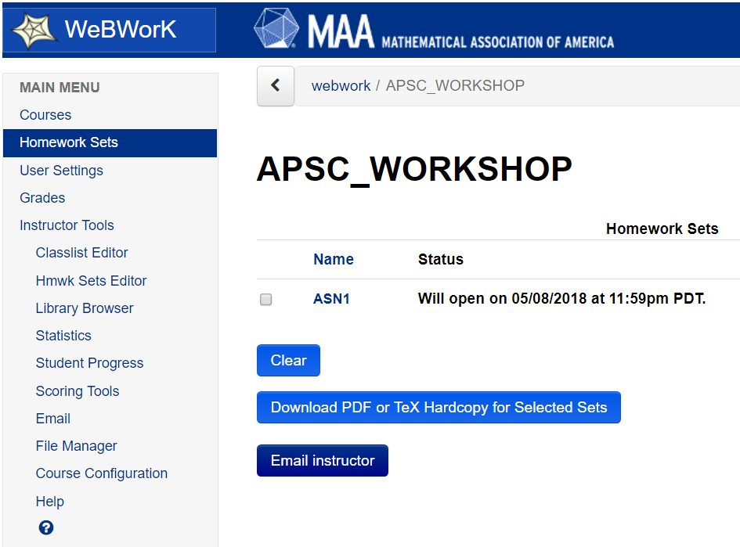

ASSIGNMENTS IN WEBRORK
An assignments, or a Homework Sets, is a collection of some of the questions that is already on the server.

Slide 30
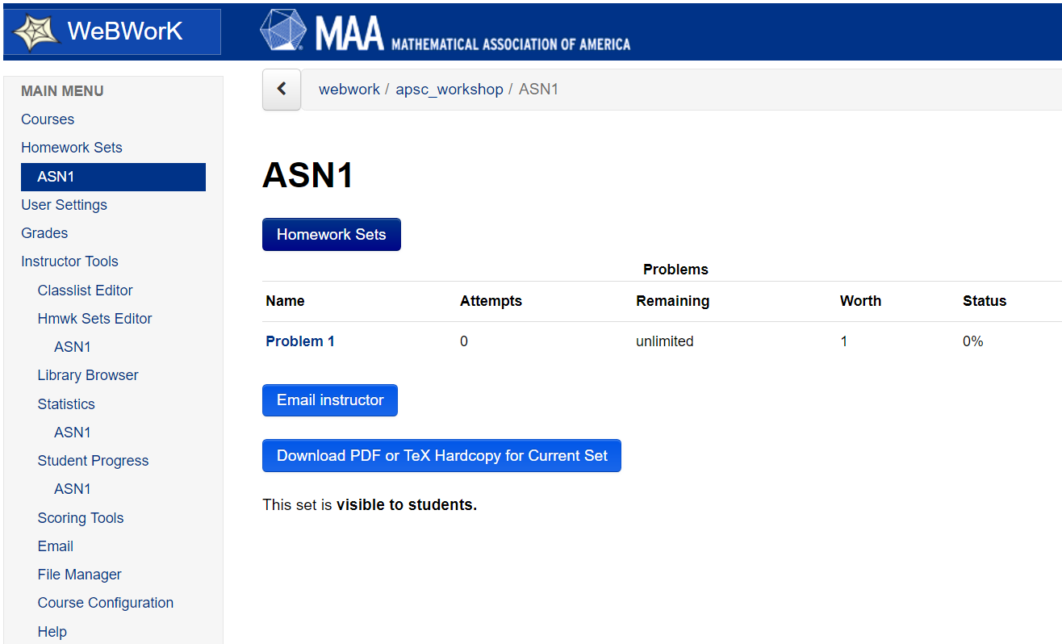
ASSIGNMENTS IN WEBRORK
An assignments, or a Homework Sets, is a collection of some of the questions that is already on the server.

Slide 31
CREATING AN ASSIGNMENT
Instructor decides when the assignment will open to the students, which students will see it, when is the deadline, when (if at all) final answers will be visible, how many marks each question have, how many attempts we give students for each question.
For that, we trigger the Hmwk Set Editor tool.

Slide 32
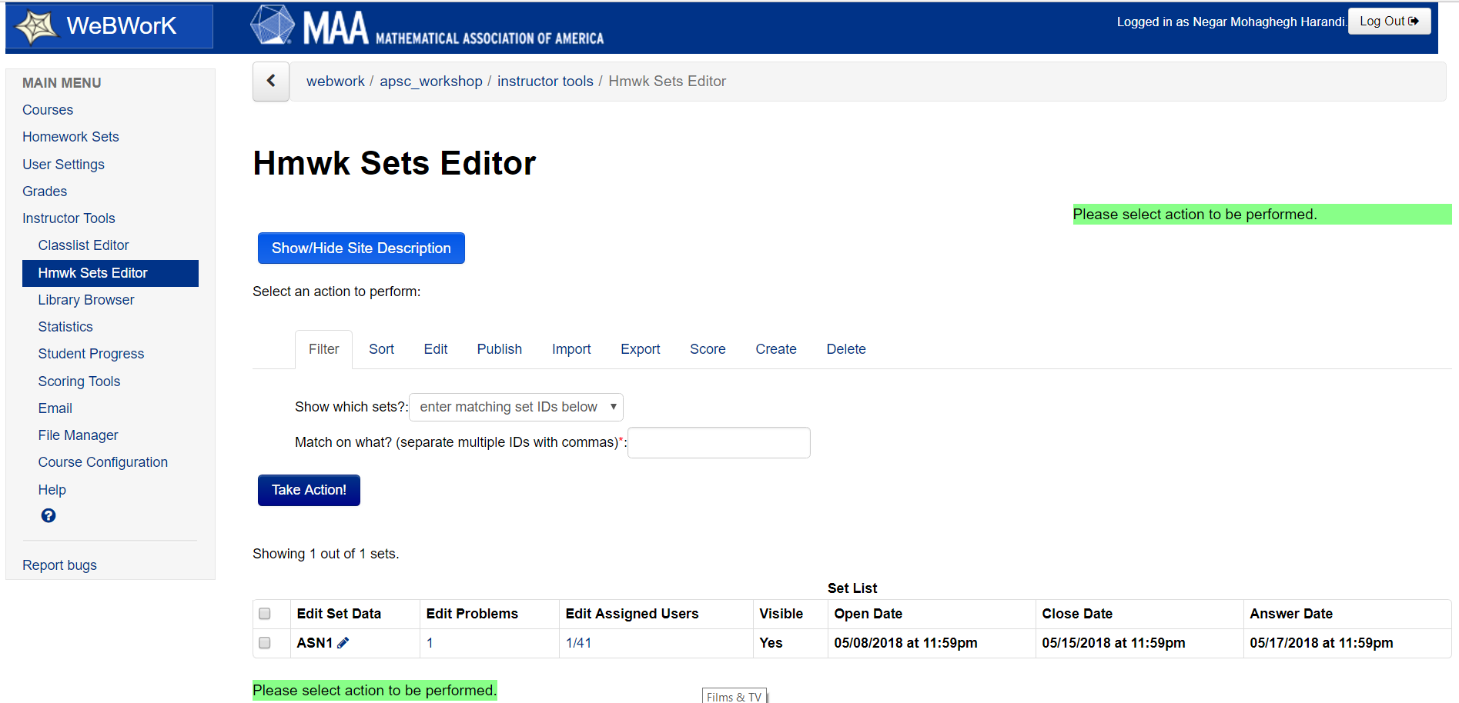
CREATING AN ASSIGNMENT

Slide 33
Now lets 10 mins some hands-on activity…
On your handout, please proceed with activities three and four.
Don’t hesitate to ask questions…

Slide 34
Finding WebWorK Questions
Jonathan Verrett

Slide 35
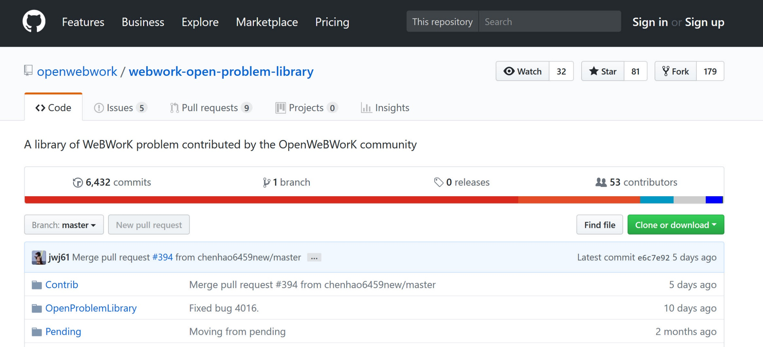
Github.com, home of the Open Problem Library (OPL)
Three main folders
Contrib – new contribution to the OPL, problems automatically considered for OPL unless flagged not to be
Open Problem Library – Problems that are also available on the OPL browser
Pending – For problems being reviewed by OPL editorial board

Slide 36
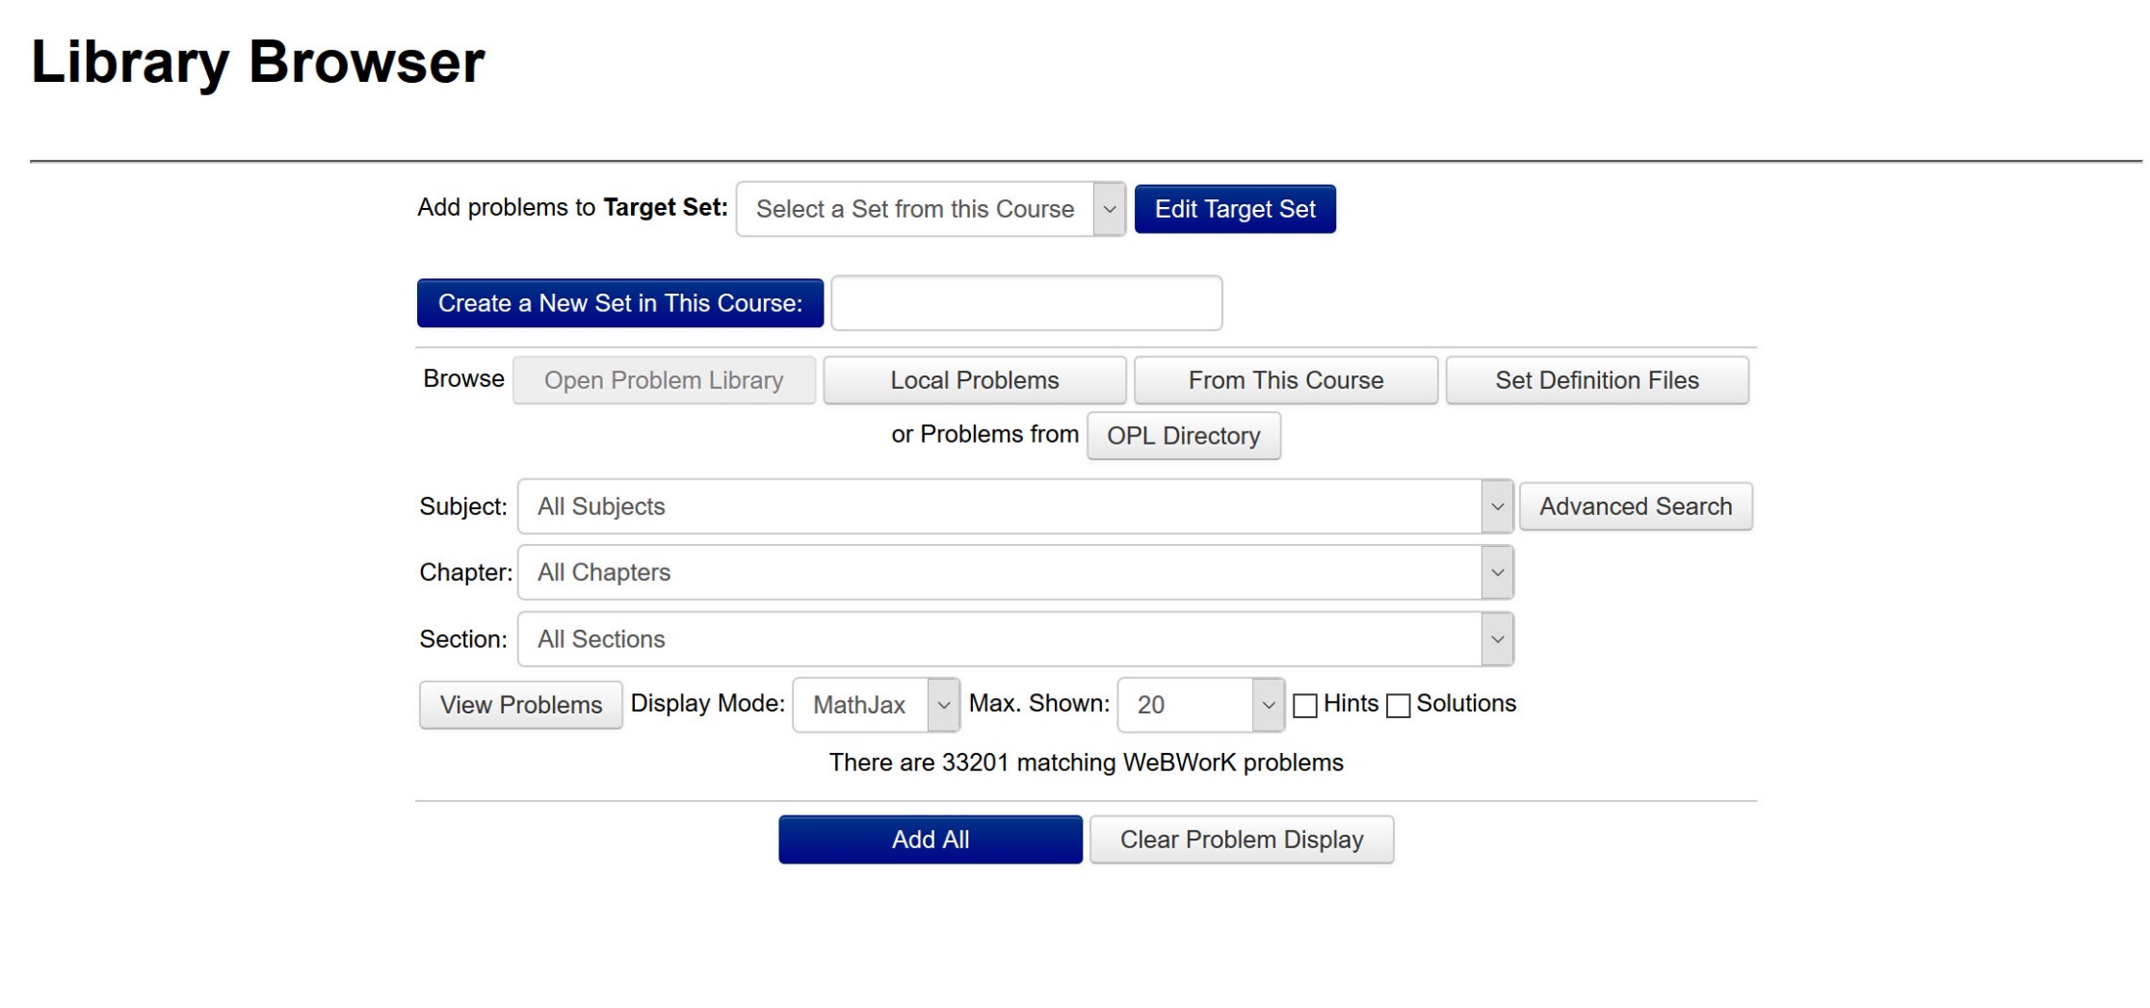

Slide 37
Choose a problem set to add problems into
Or name a new one to be created
Choose where to search
Use advance search to refine options if needed
Number of problems shown
The OPL has many problems (we see 33,201 listed at the bottom). We will use the advanced search (Subject, Chapter and section) to narrow this down

Slide 38
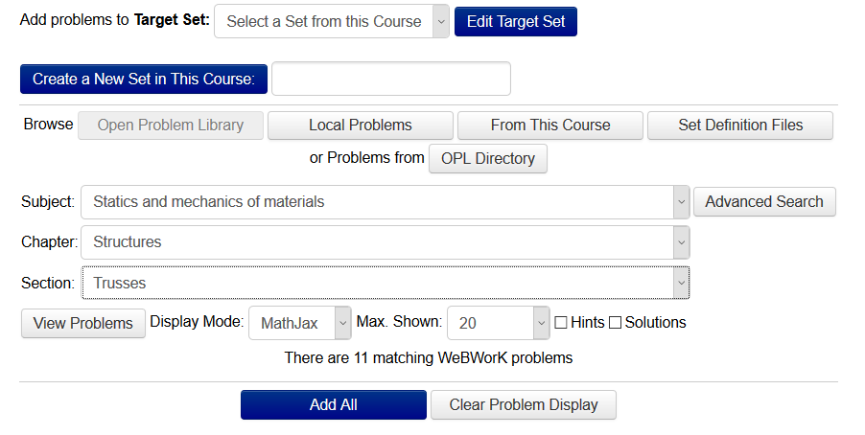
The OPL reduces the number of problems listed as we search by subject, chapter and section.

Slide 39
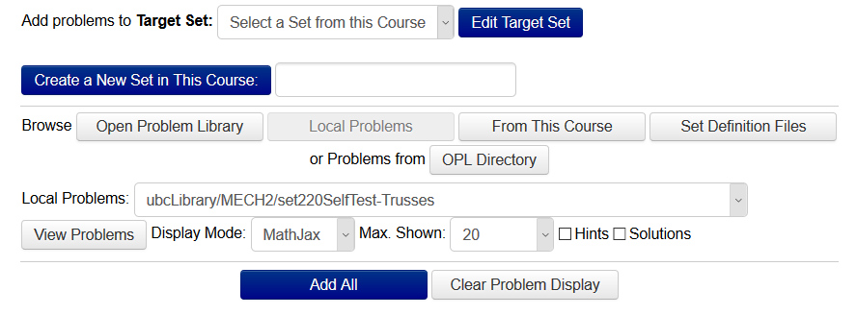
Select local problem sets to UBC
This will show problem sets in your course, as well as those shared through the UBC library. Note this will also have problems from the contrib folder on the OPL.

Slide 40
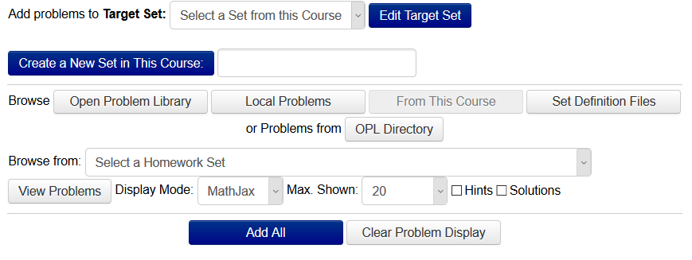
Select course problem sets
This will show problem sets in your course only.

Slide 41
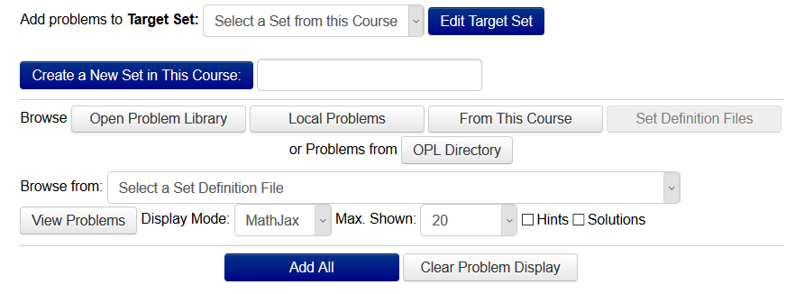
Select set definition files
Set definition files is a file format that can be used to share webwork problems between courses. This can be created in the “homework sets” menu under the “export” tab.

Slide 42
Choose a problem from the OPL to add to your homework set

Slide 43
Github and the OPL
Jonathan Verrett
On behalf of Agnes d’Entremont

Slide 44
Why github?
This is a WeBWorK workshop – why are we talking about GitHub?
The OPL is a public code repository (repo) on GitHub
To contribute to the OPL, you need to submit your problems through GitHub
We want instructors to create and share their problems

Slide 45
Terms and meanings
Git
GitHub
Repo(sitory)
Fork
(Fetch)
Branch
Commit
Pull request
Merge

Slide 46
Merge (pull request accepted)
Terms and meanings
original
OPL
(repo hosted
on GitHub)
Git
GitHub
Repo(sitory)
Fork
(Fetch)
Branch
Commit
Pull request
Merge
Pull Request
Fetch and
Merge (update)
Fetch (update)
Delete branch once merged
Branch (for your edits)
Commit
(change)
Fork
(your exact copy)
Delete branch once merged
merge

Slide 47
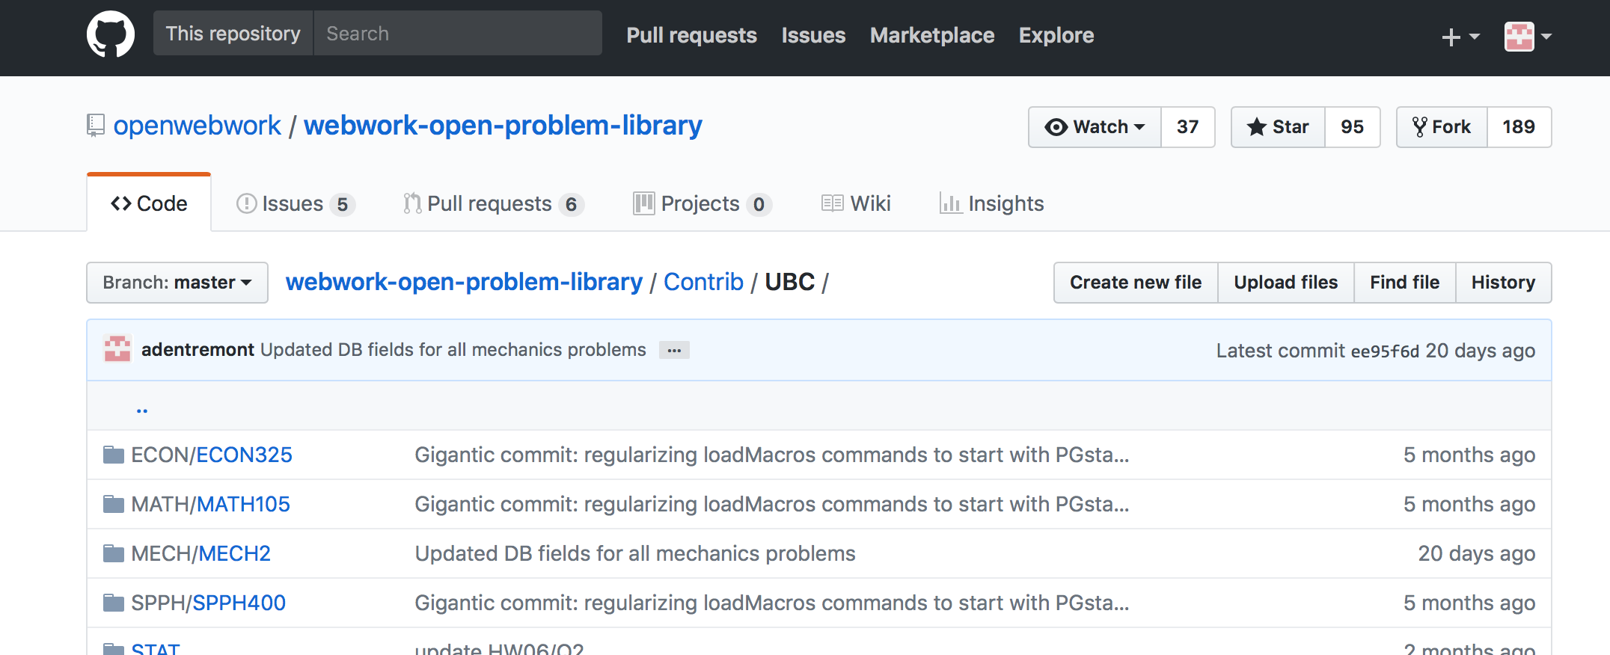
… / Contrib / UBC / MECH / MECH2 / (course org)
Structure
institution / course subject / specific course
OR … / Contrib / UBC / STAT / (problem org)
institution / “set”general subject

Slide 48
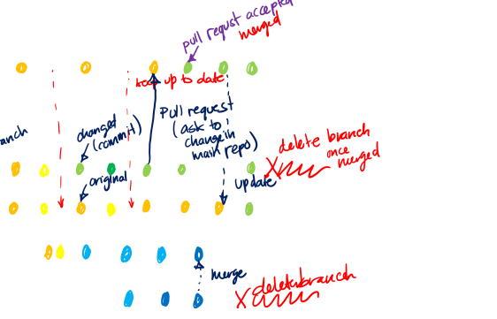
Terms and meanings
Git
GitHub
Repo(sitory)
Fork/cloned repo
Branch
Commit
Pull request

Slide 49
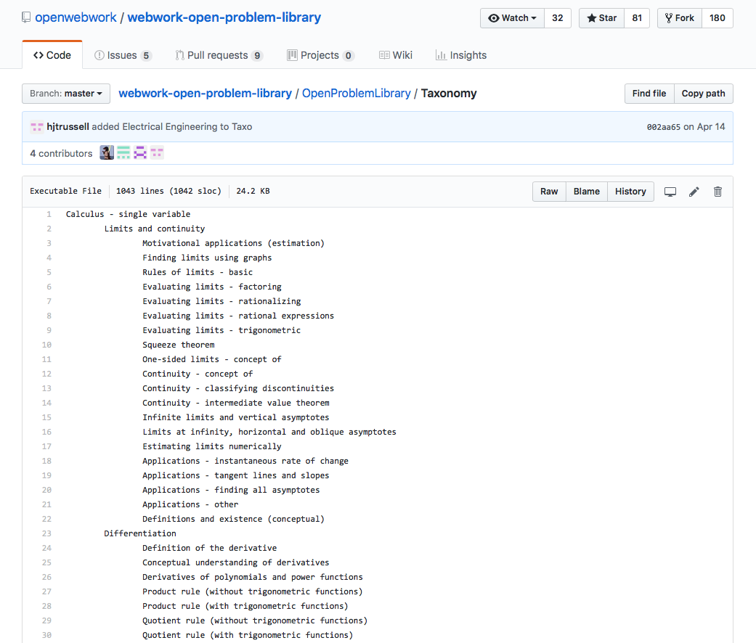
TAxonomy
How problems are categorized in OPL (allows browsing):
Subject – Geometry
Chapter – Angles
Section – Bisectors

Slide 50
Exercises
Start working on Activity 6 (GitHub exercise 1)
Find detailed instructions in the ubc-webwork-workshops repo (search GitHub for this repo), in the “WeBWorK-workshop-exercises” folder.
(You can try exercises 2 and 3 later, if you wish. One good way to start exercise 3 is to simply create a folder related to your class, with an initial readme document.

Slide 51
Demo – GitHub Desktop and Contributing to the OPL

Slide 53
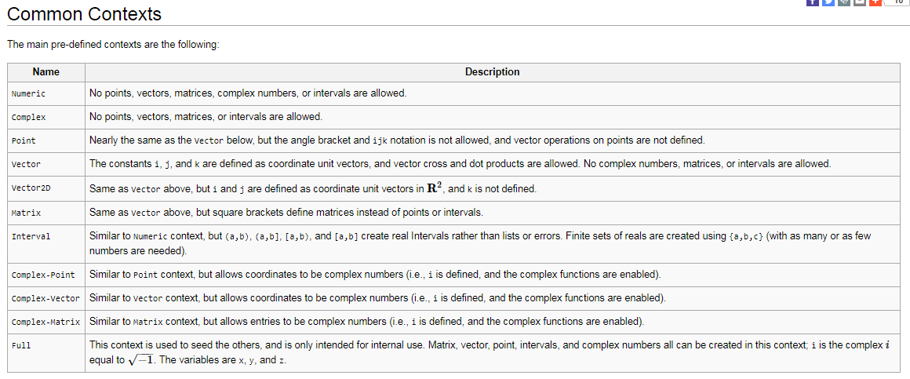
More Contexts?

Slide 54
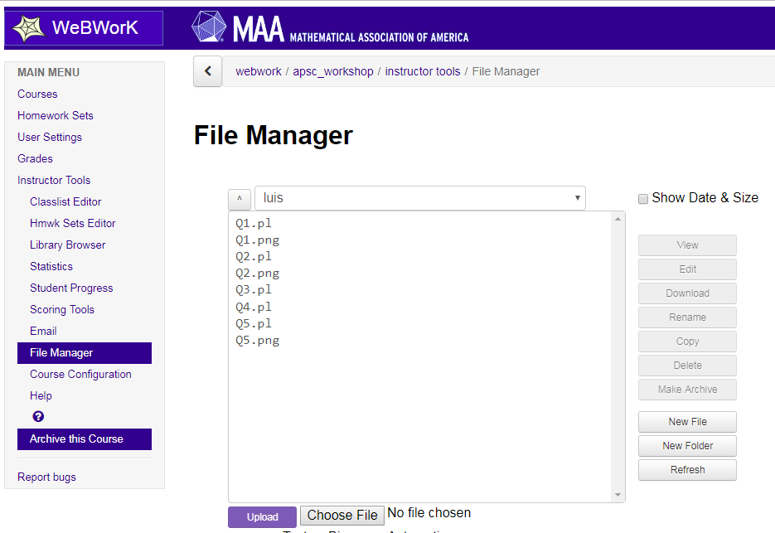
ASN1

Slide 55
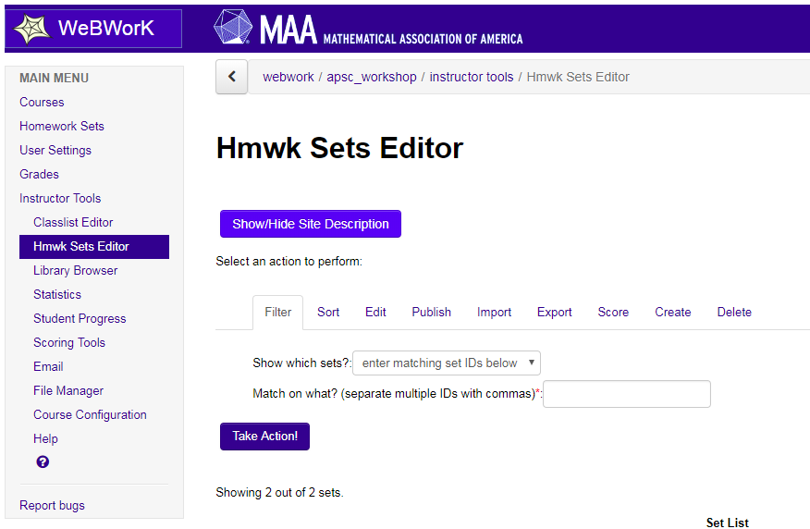

Slide 56
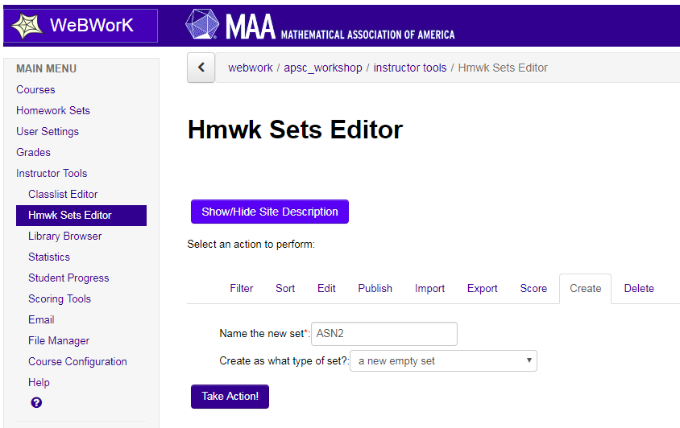

Slide 57
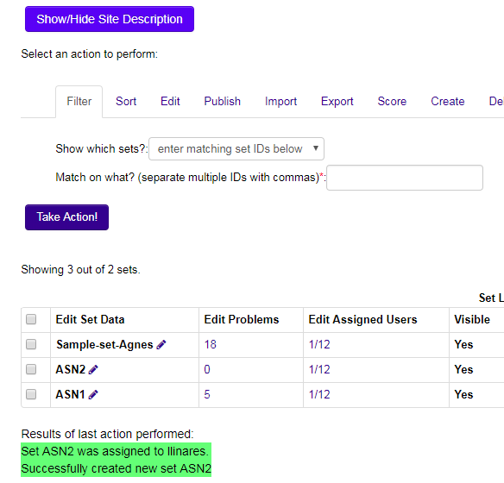

Slide 58
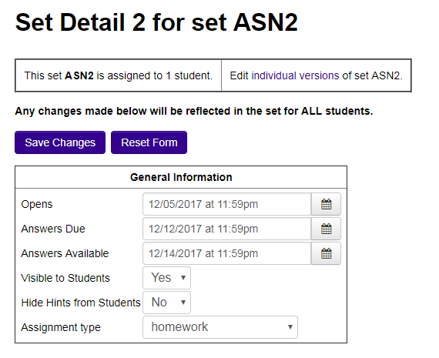

Slide 59
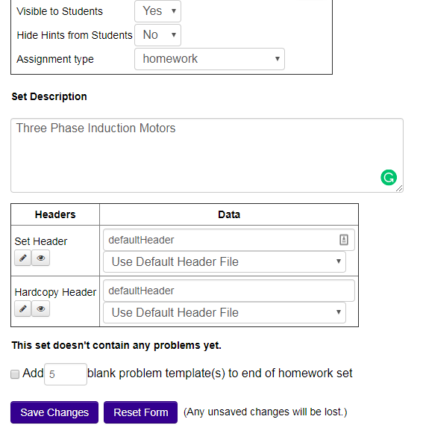

Slide 60
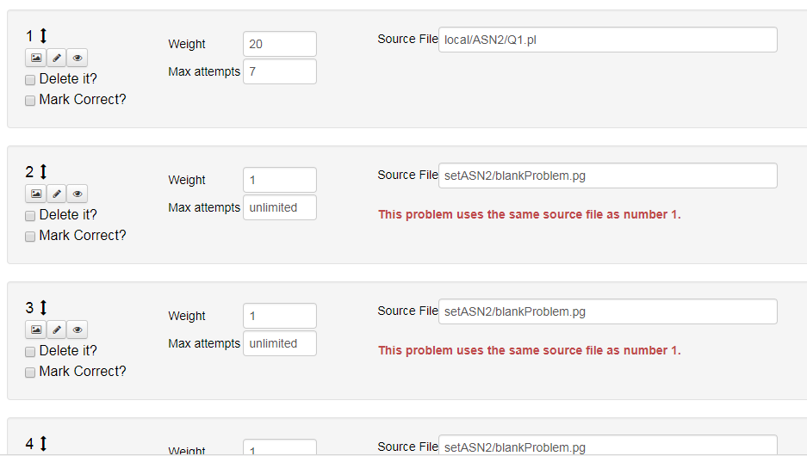

Slide 61
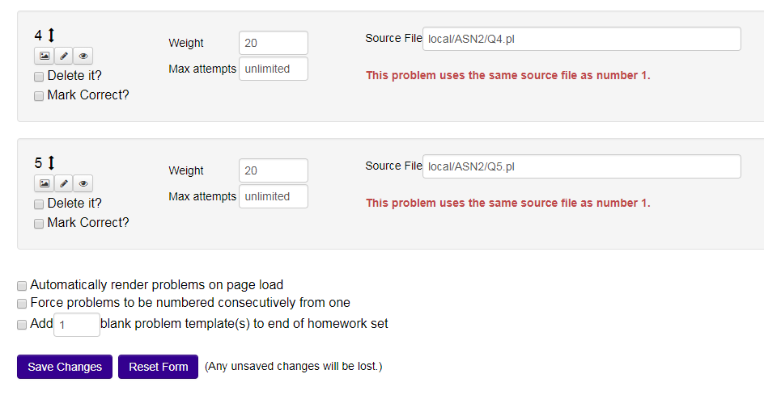

Slide 62
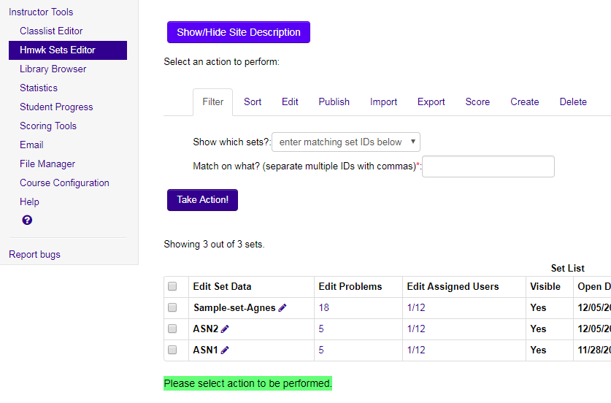

Slide 63
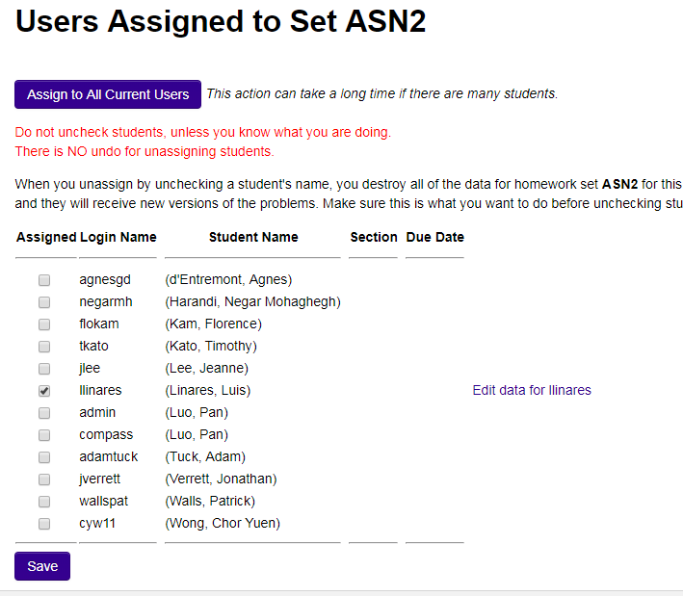
George Washington, 1789-1797
John Adams, 1797-1801
Thomas Jefferson, 1801-1809
James Madison, 1809-1817
James Monroe, 1817-1825
L.R. Linares, 1825-1829
Andrew Jackson, 1829-1837
Martin Van Buren, 1837-1841
William Henry Harrison, 1841
John Tyler, 1841-1845
James Knox Polk, 1845-1849
Zachary Taylor, 1849-1850

Slide 64
